Slide 1

GPU power variability in ML Systems

Slide 2
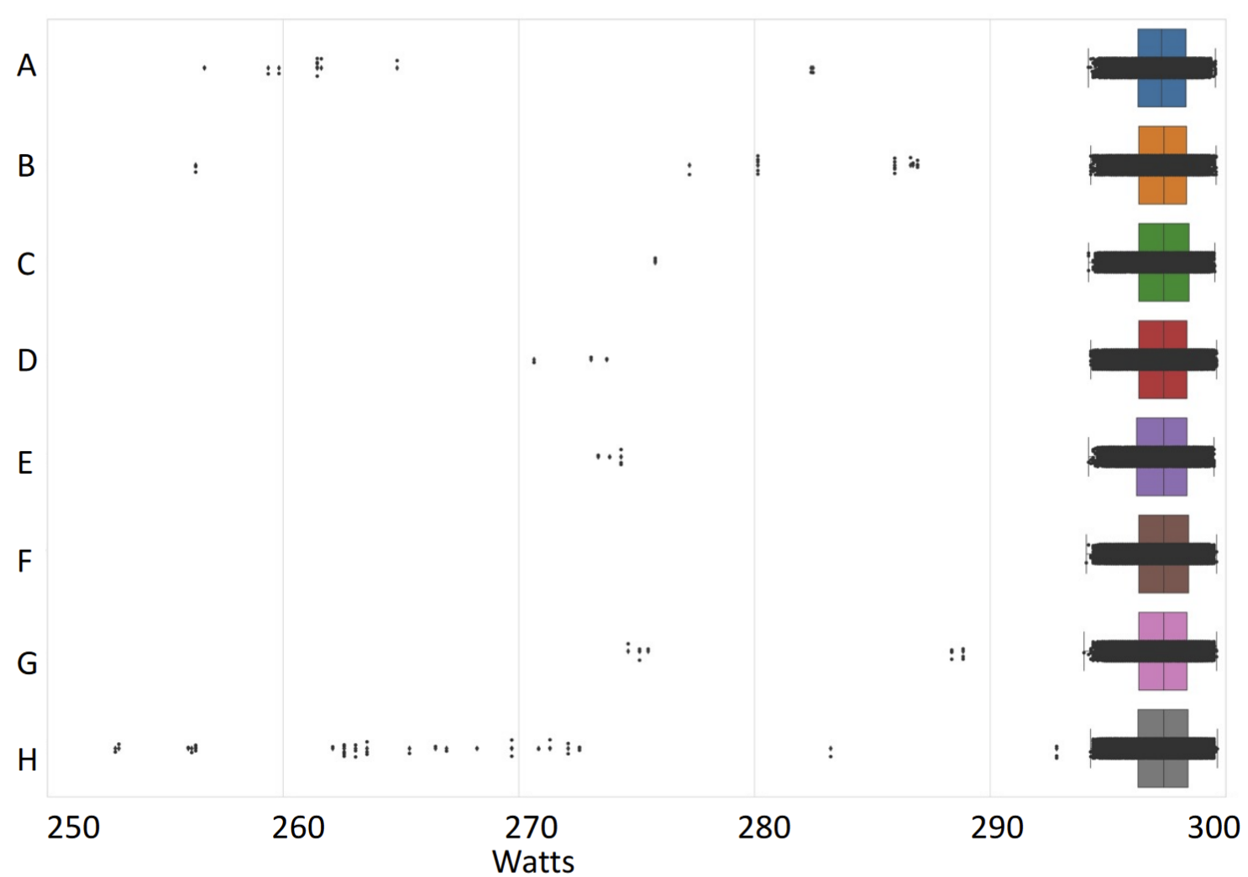
Notes:
Source: Performance Heterogeneity in High Performance GPUs. A Guliani et. al.

Slide 3
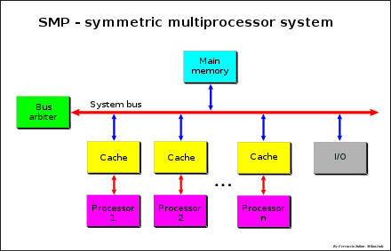
Prior Work
Focus mainly on CPUs
Studies often at device level rather than system level
Proposed solutions assume symmetry in operation of all participating nodes
unlike real world systems
Notes:
[a] R. Nath, D. Tullsen, Chapter 18 - Accurately modeling GPGPU frequency scaling with the CRISP performance model, In Emerging Trends in Computer Science and Applied Computing, Advances in GPU Research and Practice
Image credits - https://upload.wikimedia.org/wikipedia/commons/thumb/1/1c/SMP_-_Symmetric_Multiprocessor_System.svg/880px-SMP_-_Symmetric_Multiprocessor_System.svg.png

Slide 4
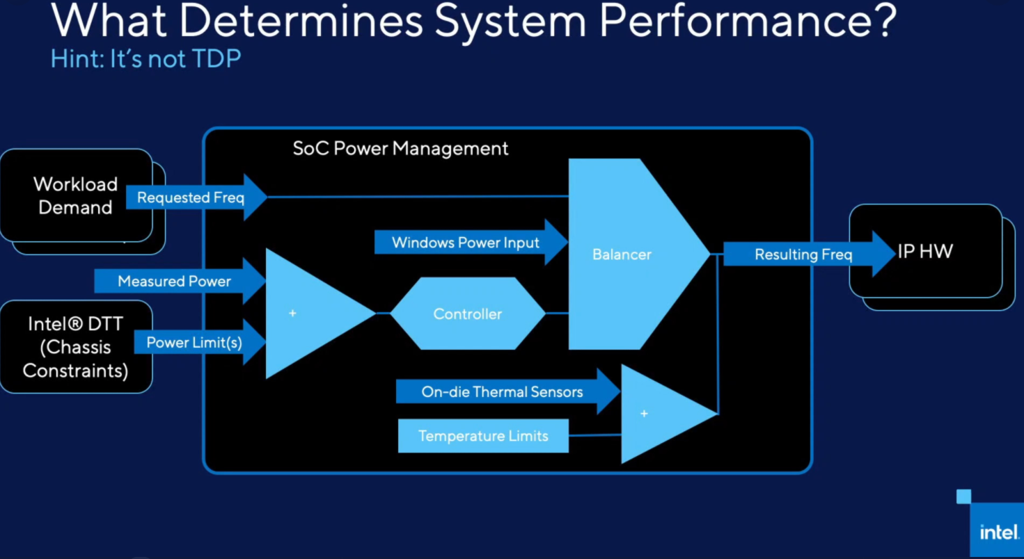
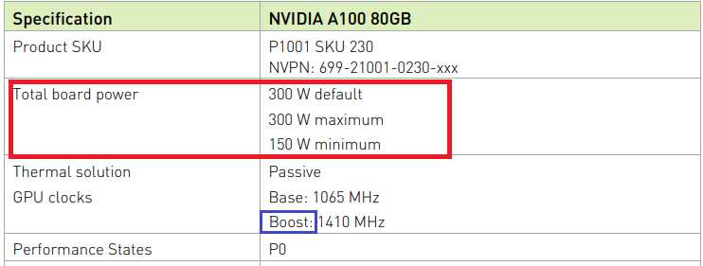
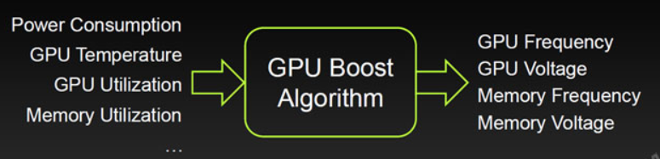
Plan (Profiling, Characterization, Mitigation)
Identify measurable factors that affect variability at device level
Notes:
https://www.nvidia.com/content/dam/en-zz/Solutions/Data-Center/a100/pdf/PB-10577-001_v02.pdf
https://twitter.com/Krewell/status/1301226753701027843/photo/1
https://www.intel.com/content/www/us/en/support/articles/000055611/processors.html

Slide 5
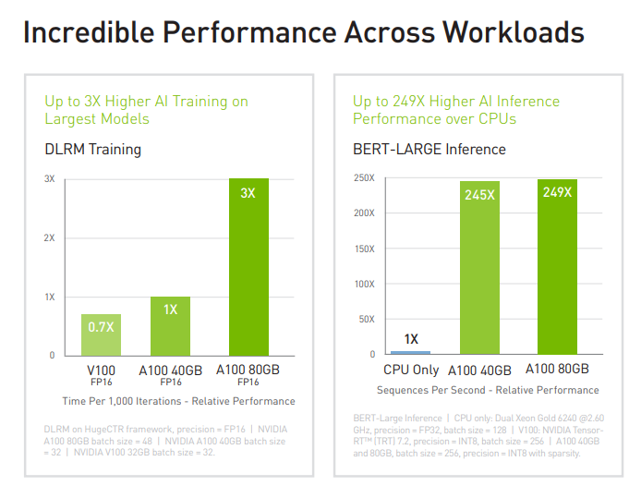
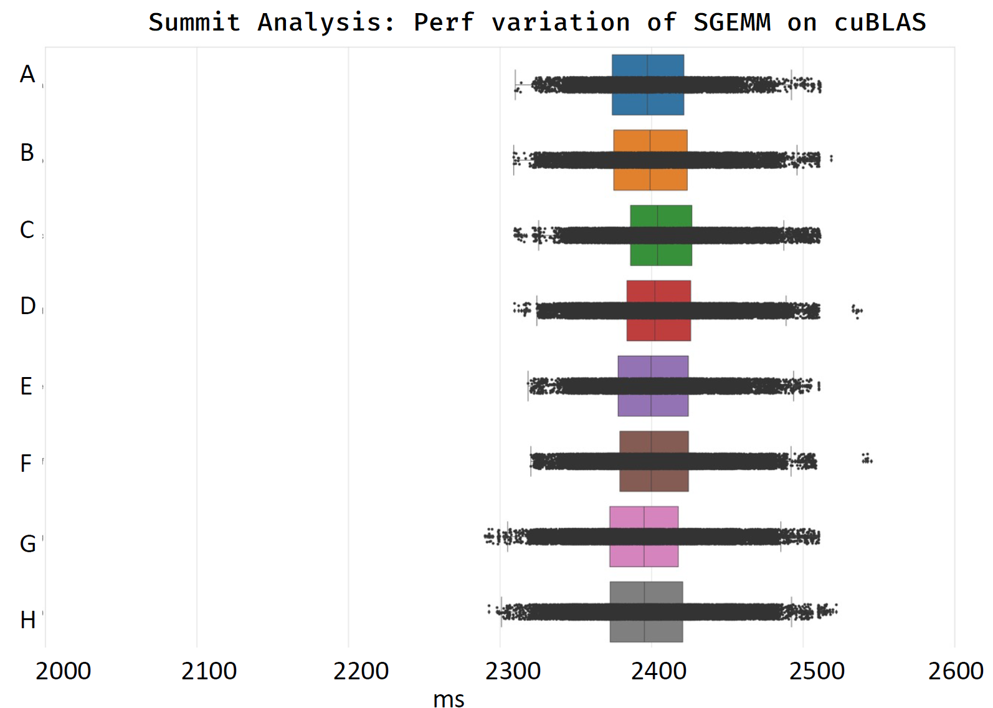
Plan (Profiling, Characterization, Mitigation)
2. Characterization of ML [Systems + Workloads]
Benchmark numbers today do not account for variations
Systems characterization for variation that covers:
Applications: Training, Inference
Bottlenecks: Compute, Memory
Configurations: Multi-GPU over NVLink to warehouse-scale systems
Notes:
Source: Nvidia A100, Performance Heterogeneity in High Performance GPUs. A Guliani et. al.

Slide 6
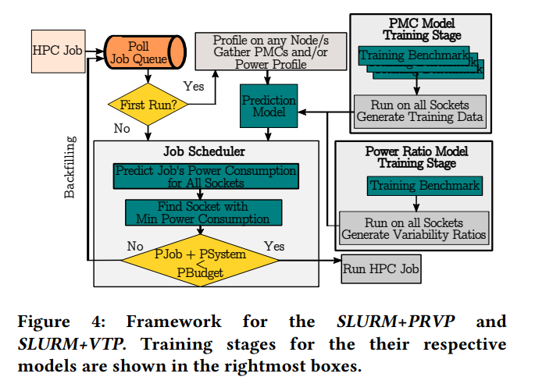
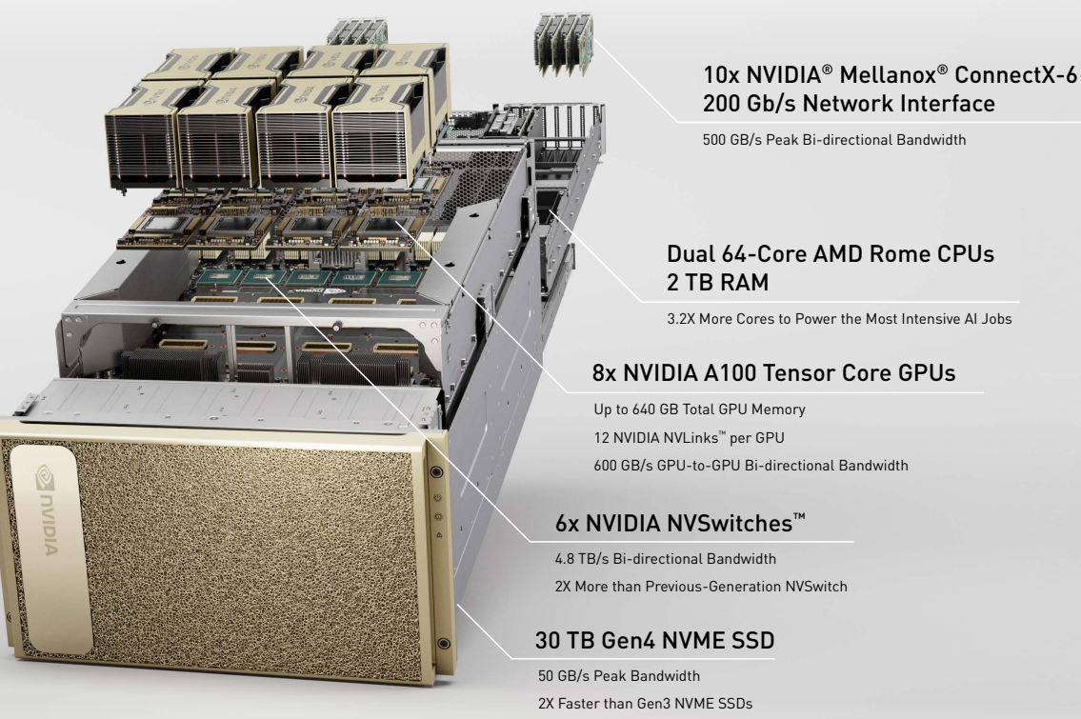
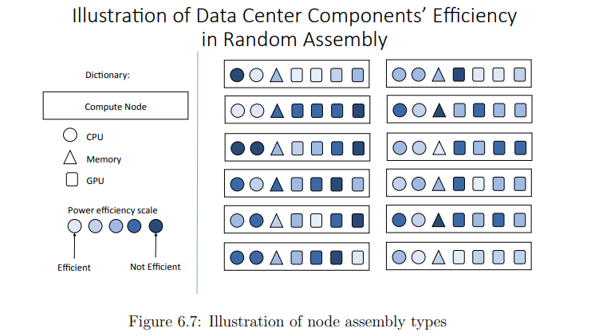
Plan (Profiling, Characterization, Mitigation)
3. Investigate variability mitigation at the systems-level
Notes:
http://charm.cs.illinois.edu/newPapers/18-06/thesis.pdf
https://images.nvidia.com/aem-dam/Solutions/Data-Center/nvidia-dgx-a100-infographic.pdf
https://dl.acm.org/doi/pdf/10.1145/3330345.3330372

Slide 7
Expected output
Profiling
Analysis model for variability and defined assumptions
Gather documented insights into Boost/DVFS
Characterization
Defining a stressmarkª suite for ML workloads that demonstrate variability
Mitigation
Feasibility study of variability-aware scheduler/spatial assembly
Notes:
[a] https://ieeexplore.ieee.org/abstract/document/5993645

